Slide 1
FRAME
(Food Recommendations For All Methodical Eaters)
Zachary Bowyer, Arjun Sharma, Raman S V, Adithyaa Vassen

Slide 2
Background
The current popular methods of ordering foods (Uber Eats, Doordash) have a few issues
“Analysis Paralysis”
“Doom Scrolling”
We propose a simple filter-based recommender with two key aspects
Recommend a small number of dishes
Focus more on dishes instead of restaurants
In essence, this project is a ‘tool’ that helps us analyze our food choices from pre-existing data sources and acts as a customized food recommendation system

Slide 3
Data used
UberEats
Kaggle dataset collected via web scraping using python libraries
Limitations:
Not currently up to date (7 months old)
Might not include every Seattle restaurant
King County Food Inspection
Seattle/King County public health department updates database with inspections as they occur; We downloaded most recent dataset
Limitations:
Since it seems data is manually updated, it is possible data could be missing, and it would be difficult to know
‘Uszipcode’ data
Dataset collected from crawling/scraping data.census.gov
Limitations:
Not perfectly up to date, but doesn’t really affect our use case
‘Googlemaps’ database
Data obtained by Google through employing many different expensive methods to construct highly accurate maps
Limitations: Needs api key to access data, limited rates

Slide 4
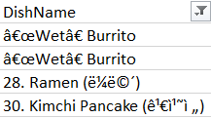


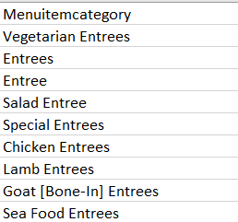
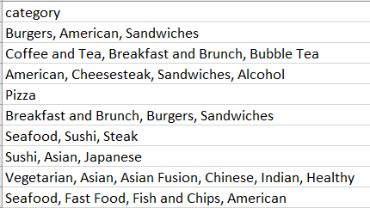
Data Cleaning
Noise
Merging Addresses
Inspection data
Restaurant data
Menu Category Fix
Restaurant Category Fix

Slide 5
Use cases
At a high level, the app provides users with 5 dish recommendations on what they would want to eat based on their filters. The app has the below filters -
Seattle area Zip Code: the user has to select the Zip code of the area they want results for
Maximum distance (miles): the maximum distance the user would want a restaurant to be in
Restaurant Category: one of 25 categories such as African, Asian, American etc.
Food category: categories such as Appetizers, Entrees etc.
Maximum Price ($): price preference, on a scale of $ to $$$$ (similar to the Google Maps display)
Restaurant rating: rating preference on a scale of 5 stars
Health Inspection Results: where available, provide the latest health inspection results details
Extrovert level: a filter for the user’s current mood, ranging from takeaway to a giant seating capacity of 250+
The user can select a combination of their choices from above and the app will display a set of 5 results

Slide 6
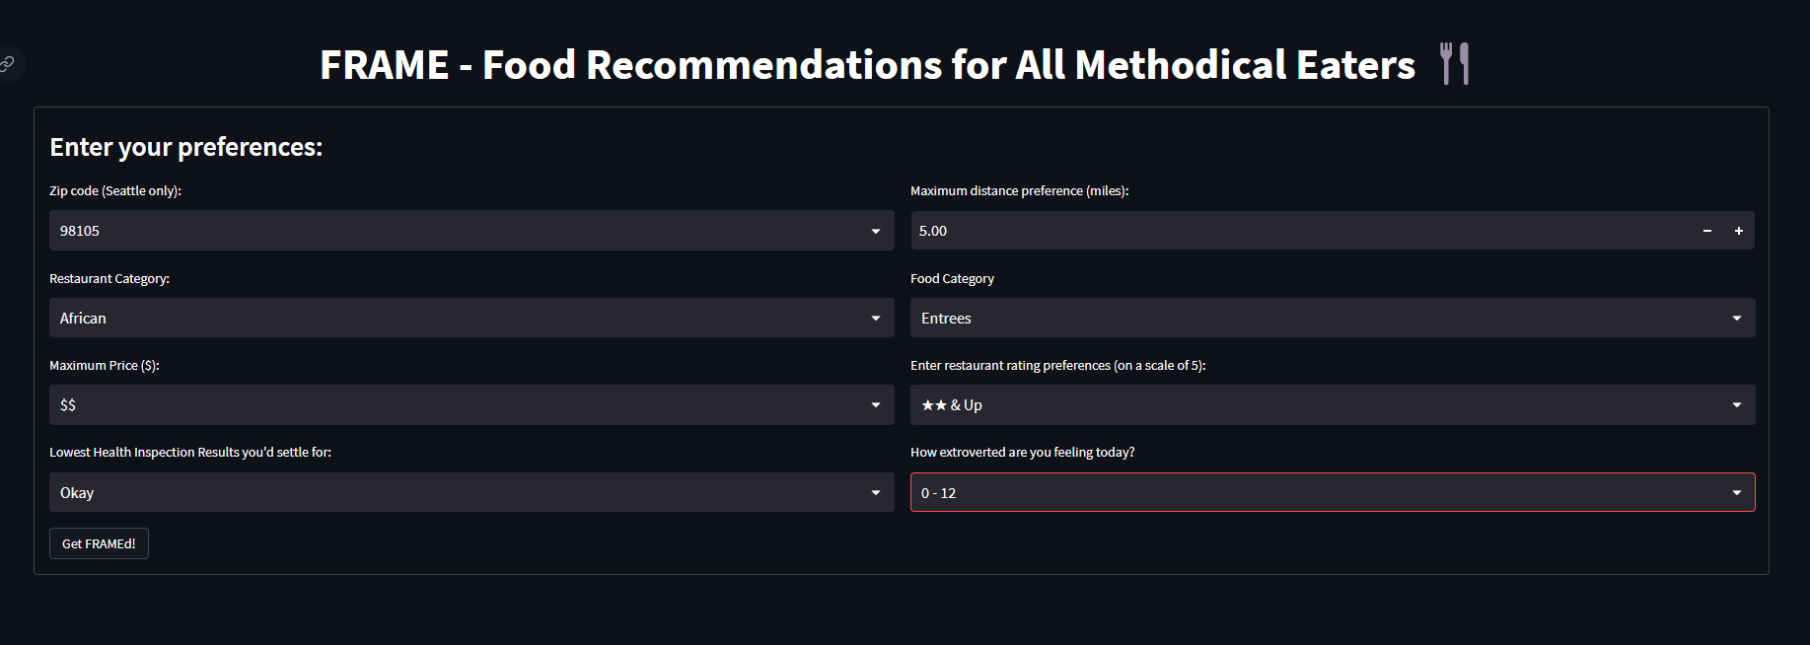
Use cases - Filters
Example screenshot of the options a user has selected

Slide 7
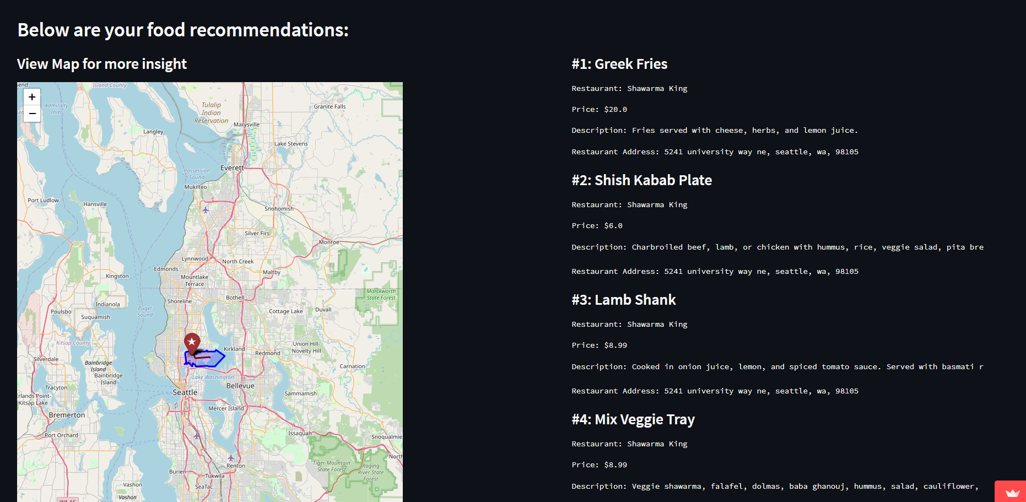
Use cases - Results
Example screenshot of the results based on the filters from the previous slide

Slide 8
Design and Components
FGMap
Python module that employs both Folium and Googlemaps api to construct dynamic maps that show addresses, directions, and zip codes
Data preprocessor
Reads restaurant & menu data, combines with Inspection data using fuzzy mapping.
Limitations: Directions overseas don’t work, directions are inaccurate over long distances, map needs to be recreated each time data changes
Cleans Item category, Restaurant category by mapping it to new set of values that are manually created. The output of this module powers the front end. Limitations: Static file that has to be run manually, any change has to be updated by hand
Streamlit app
Creates front end instance of streamlit including the design elements
Takes the input data file form the Data Pre-processor component and filters them based on the inputs from the front end
Takes the input maps from FGMaps and renders the results from the filters overlaid on the map

Slide 9
Demo
Video Link - Team FRAME Front End Demo
Demo link: Team FRAME Live Front End link

Slide 10
Lessons learned
Conda environments can be complicated across platforms
sqlalchemy (>=1.4.1<2.0.0) vs sqlalchemy (>=1.4.1,<2.0.0) for building environments
Pip install vs conda install, some packages didn’t exist on conda
Getting environments to work for Mac, Linux, and Windows
Making sure used packages are compatible with various platforms
Conda environments, setup.py, and shell scripting can be combined to make it very easy for people to quickly run your code including the data needed to provision this
Continuous integration is a powerful tool for ensuring code quality and consistency
Enforcing timelines and schedules in a college environment is very different from a professional setting.
Need to strictly enforce deadlines and follow up on a regular cadence
Freezing branches and code for important events such as demos so that code isn’t broken by last minute changes
Strict Version control and release of software
Streamlit
Dealing with free/freemium add-ons such as GoogleMaps , need to keep a track of what is allowed and when it expires
Hosting and caching , needing to understand how server architecture works

Slide 11
Scope for Future work
From the original pitch we had presented -
Viewing and searching for specific restaurants
Filtering entire menu items from a subset of restaurants
Automate the data cleansing and loading on a weekly cadence
Extending the range to beyond the Seattle area
Including a recommendation system that leverages past user data and ML algorithms

Slide 12

THANK YOU! Eat Healthy, Spend Wisely

